Slide 1


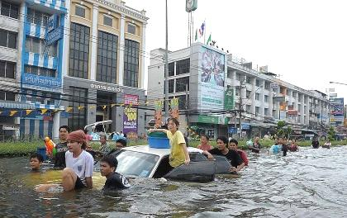
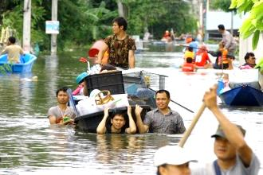
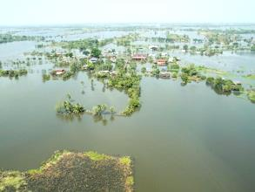
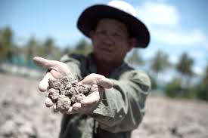

National vision on flood and drought management
Dr. Somkiat Prajamwong
Secretary - General
Office of the National Water Resources (ONWR), Thailand
6th June 2018
United Nations Conference Centre, Bangkok, Thailand

Slide 2





Past experience : Extreme Flood and Drought
“Average rainfall is 46% lower than normal”
“Impacted of 13.43 Million people ”
Meteorological
drought
“Impacted of 4.04 Million households ”
“Water levels at 45% of whole reservoirs capacity”
“Damage cost THB 1,440 billion”
Hydrological
drought
“Rain-fed rice plantations is suffering in the major basin i.e. Chao Phraya river basin”
“GDP revised down from 2.6 % to 1.0 %”
Agricultural
drought
Source: Bank of Thailand /World Bank
2

Slide 3

Office of the National Water Resources: ONWR
ONWR
Policy advisor
Regulator
Facilitator
Operator
Ministerial Declaration
An urgent call for decisive action on water
17. Support the strengthening of transparent, effective, inclusive and accountable national and, where appropriate, subnational water institutional arrangements, with participation of all relevant stakeholders and consideration of local circumstances in the policy-making process, while fostering necessary partnerships, confidence building, exchange and sharing of information and experiences among public, private and civil society actors;
3

Slide 4




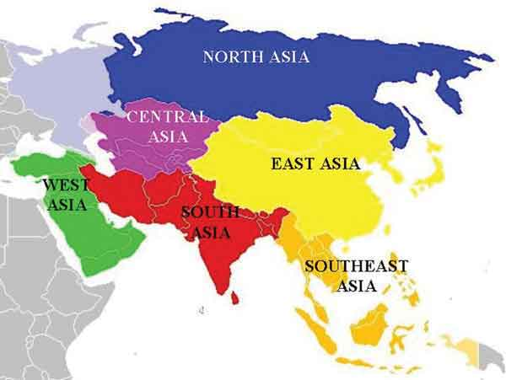

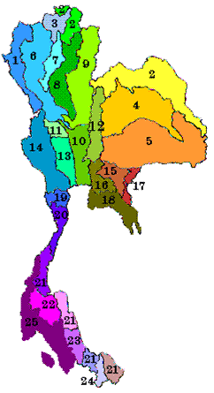




Future Vision : Strategy and Policy
20-Year Thailand’s Strategic Plan
Strategy Plan for Water Resources Management
National Water Resources Committee ONWR (Secretariat)
Water Resources Management
Data Base
Strategy and
Master Plan
Work Plan + Budget
4

Slide 5
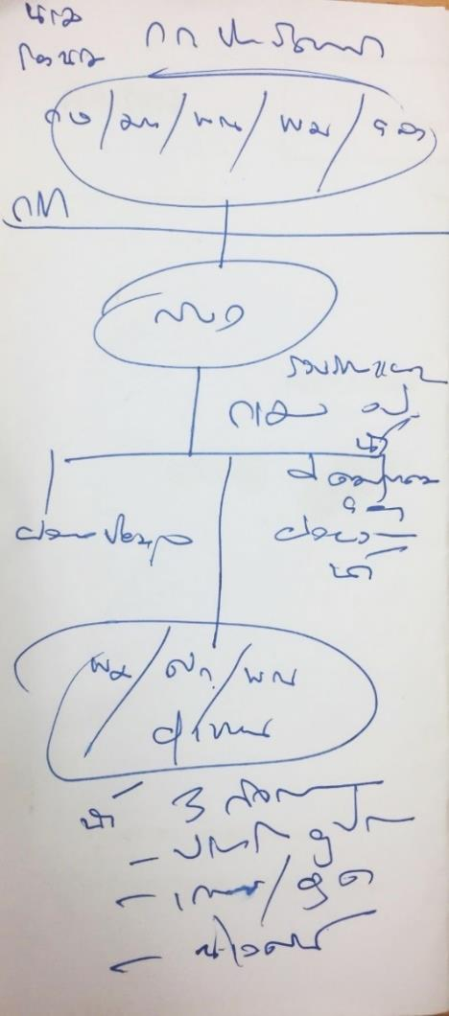
Management : National Water Resources Committee
PM
DPM
MOAC/MNRE/MIF
ONWR
Data Base
Work Plan/Budget/
Management
Operators
Water for 3 Activities
Consumptions
Agriculture/Industry
Ecology
5

Slide 6

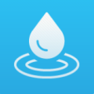


3 Mechanisms of Water Resources Management
Linkage
Management
Policy
Organization
• The 20-Year National Strategy
Water Resources Management
• The National Water Resources Committee
• A 12-year water resources management strategic plan
Office of the National Water Resources
Basin Committee
Linkage
Management
Linkage
Act
Water Resources Act + Ministerial Regulations
6

Slide 7




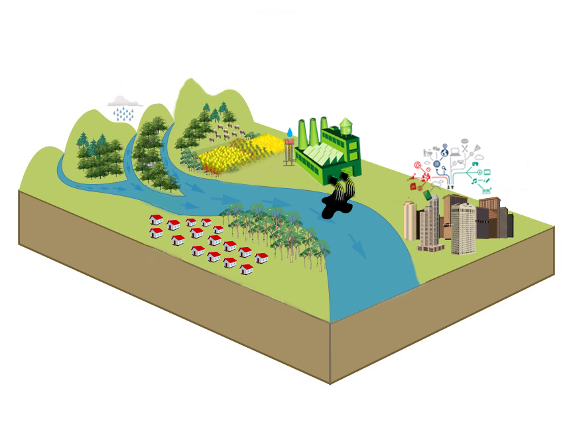





Policy : Water Resources Management Strategy 2015-2026
Creation for Water Security for Production (Agri. + Ind.)
9,500 million m³ (2,358 million m³)
Area 1.36 million Ha. (382,400 Ha.)
Water Quality Management
248 systems
(53 systems)
Upstream Forest Conservation and Soil Erosion Prevention
Area 763,200 Ha. (58,956 Ha.)
Management
Organizations
Legal of water resource
Decision Support Data System
Public relations and participation
Water Management for Consumption
7490 villages (7,234 vilages)
Flood Management
Protection Flood 168 cities (63 cities)
Dredging 870 km. (292 km.)
7

Slide 8


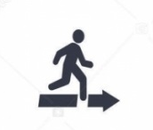






Act : Timeline of drafting a Water Act
Draft of Water Resources Act B.E. … reviewed by cabinet
Drafting Water Resources Act B.E. …
Public Hearings
(10 times)
Water Resources Act B.E. .. submitted by cabinet
30 Sep 2015
21 May 2018
2 March 2017
To be reviewed in the 2nd stage
To be voted in the final stage
Being in the process of consideration by Extraordinary Committee …
Draft of Water Resources Act reviewed by NLA
Appointed Extraordinary Committee ...
Public opinion and suggestion
Draft Revision

Slide 9
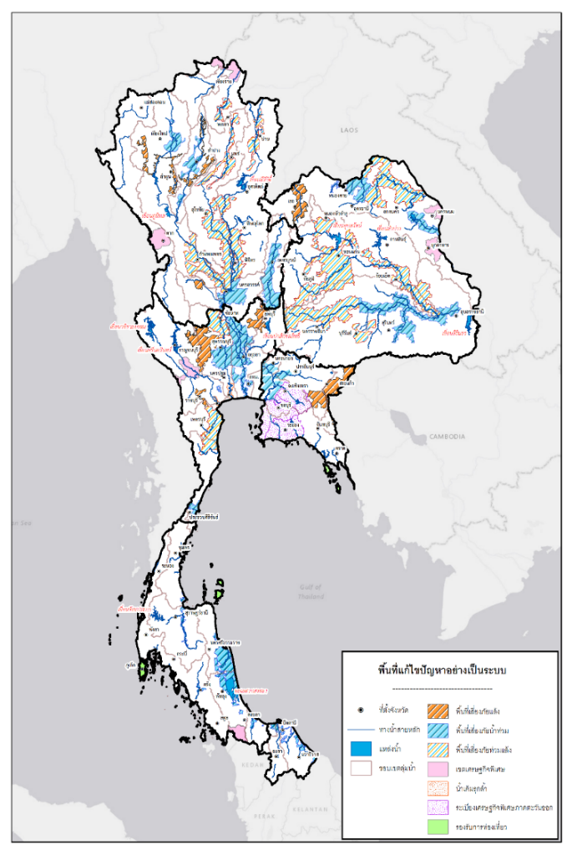
Management: Flood and Drought Resilience (Area Based)
Area-Based |  |  | Problem Area |  | Developed Area
 | Number of places | million hectare | Number of places | million hectare | Number of places | million hectare
Total Area | 66 | 4.75 | Flood 28 Drought 11 Flood and Drought 12 Saltwater intrusion 2 | 1.32 0.50 0.34 0.05 | SEZ 10 Tourist site 3 | 1.88 0.12
North | 16 | 0.98 | 14 | 0.67 | 2 | 0.31
Central | 13 | 1.13 | 12 | 0.99 | 1 | 0.15
Northeast | 12 | 0.71 | 10 | 0.50 | 2 | 0.20
East | 11 | 1.56 | 6 | 0.41 | 5 | 1.15
South | 10 | 0.35 | 7 | 0.16 | 3 | 0.19
Southern Border | 4 | 0.03 | 4 | 0.03 | - | -
Note: Consideration of Area Based must enhance public involvement and opinion into account.
* Urgent development area such as special economic zones and tourism location.
9

Slide 10
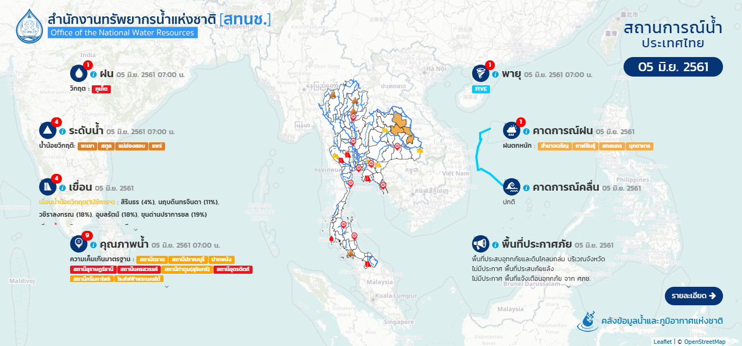
Management Tools : Flood and drought
Current situation
Forecast
rain
Tropical storm
Water level
Rainfall forecast
Dam/ reservoir
Wave forecast
Water quailty
Disaster declared area
Information / situation
Thailand flood and drought information system
Thailand early warning system
10

Slide 11
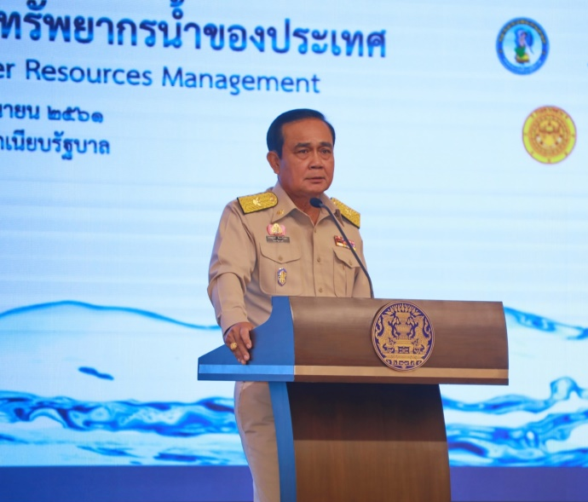
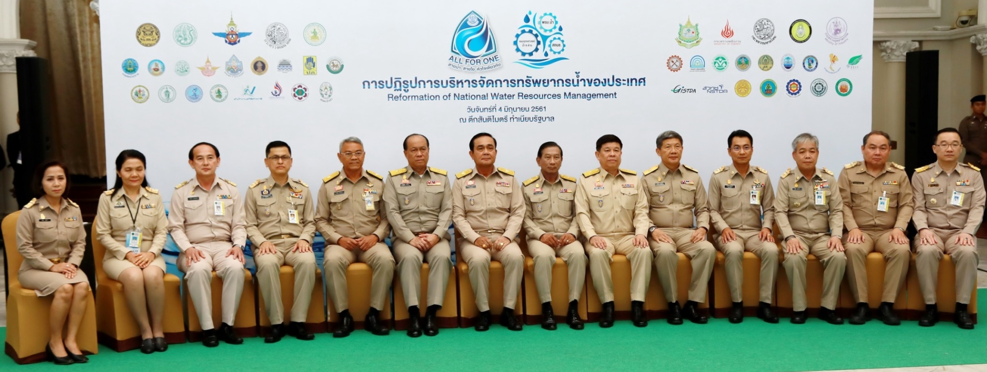
Awareness raising: National level
4th June 2018, Government House of Thailand
Prime Minister pointed out his administration has already endorsed a total of 216 water projects worth 4 billion baht, increasing water supplies by 27 million cubic meters and covering 900,000 rai of farming and residential land, adding that 3,000 more projects are being reviewed by responsible committees
11

Slide 12
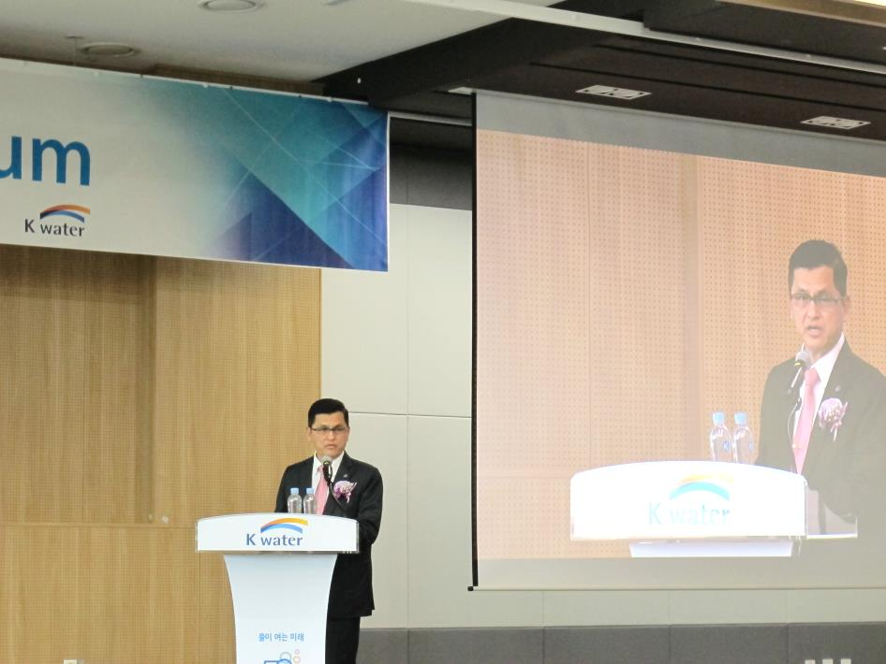
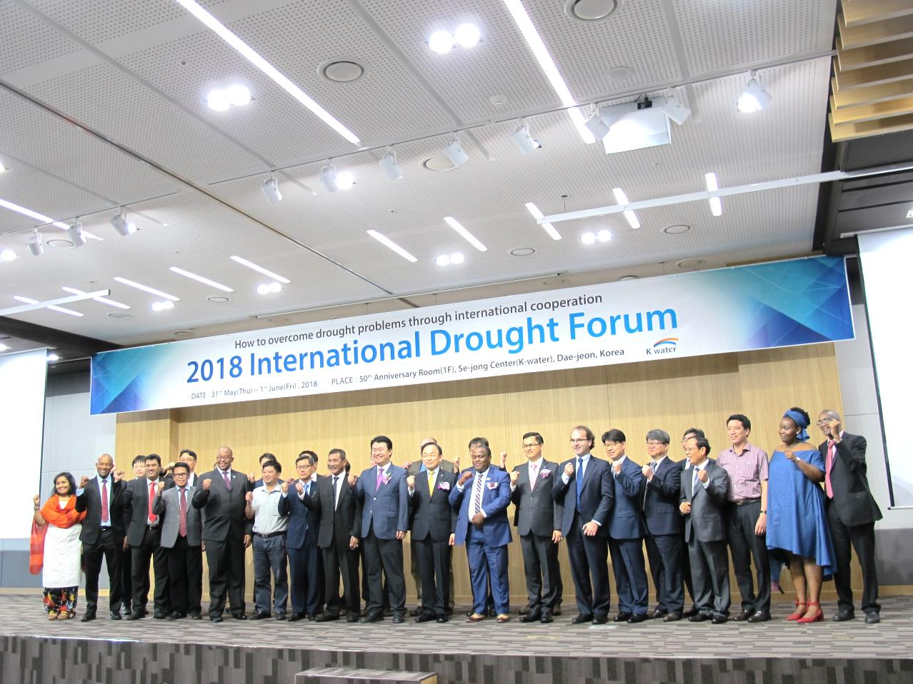
Awareness raising: International Level
31st May 2018 , Daejeon, Republic of Korea
Secretary – General of ONWR is a keynote speaker for the 2018 International Drought Forum. Outcome of this event is sharing the practical and insightful knowledges, our experiences, and networks in solving drought related issues. Under the main theme “How to overcome drought problems through international cooperation”
12

Slide 13


Thank you
http://www.onwr.go.th/
http://daily-report.onwr.go.th/thaiwater30/

